Slide 1


A Look at Common Issues
Notes:
We’ll take just a minute to look at some common entry issues

Slide 2

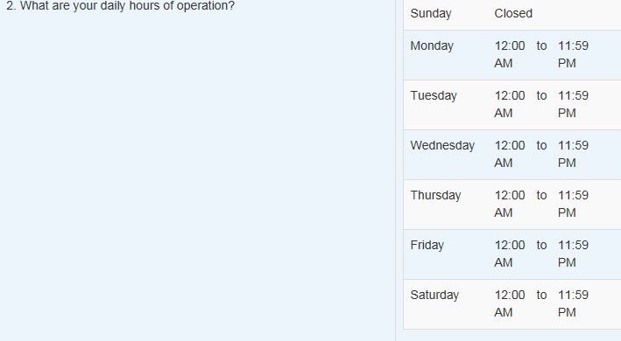
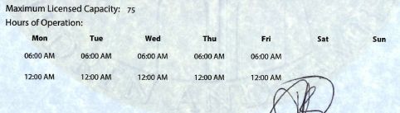
EFSM Provider Profiles
License doesn’t allow 24 hour care
Notes:
On the left is the DCF license and on the right is the EFSM entry. In this case, the license doesn’t allow for the 24 hour care entered. The license and hour entry must match of the EFSM entry must be less than the max allowed by license.

Slide 3

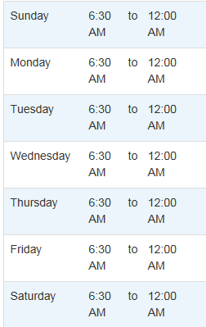
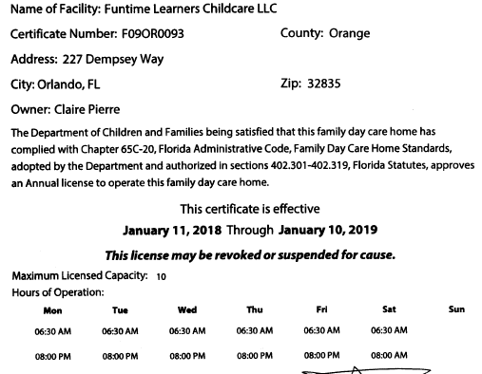
EFSM Provider Profiles
Open for 90 minutes on Saturday morning?
Follow up with DCF to correct information
Mismatch of EFSM hours and DCF information
Notes:
In this case, there’s likely a typo on the DCF information. Saturday 8:00 am should likely be 8:00 pm unless the provider is only open for 90 minutes early on Saturday morning. This situation would require DCF to make the correction before the profile could be made accurate.

Slide 4
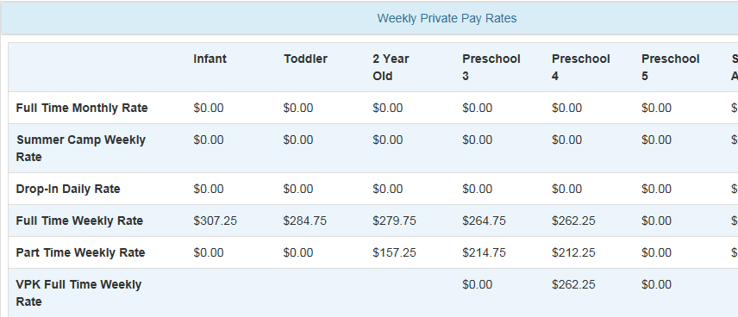
EFSM Provider Profiles
Provider can’t be paid for 5 year old children not in school. Impacts SR and VPK.
Notes:
In this case, the provider has no rates for 5 year old children and couldn’t be paid for SR or VPK.

Slide 5
Review
The Profile will have one of these statuses:
Incomplete
Request Assistance
Submitted
Coalition Reviewing
Active
Inactive
Rejected
Provider Control
Coalition Control
Static Until Changed
Provider Control
Notes:
After review, the provider profile will have one of these statuses. The provider needs to monitor and react to those under provider control. Once Active, the Coalition can initiate the contracting processes for SR and/or VPK. Contracts cannot be initiated in any other status.

Slide 6
EFSM Provider Profiles
Provider Profile Status Definitions
Incomplete
The profile is not complete. The provider has to complete the required fields, certify, sign and submit the profile.
Coalitions cannot change the status of an Incomplete profile; however, coalition users have read-only access to assist the provider in completing the profile.
Request Assistance
The provider needs help to finish or edit the profile.
Notes:
Read slide

Slide 7
EFSM Provider Profiles
Submitted
The profile has been completed and submitted by the provider for coalition review. The profile is not editable by the provider while in Submitted status.
Coalition Reviewing
Providers can't edit in this status.
Notes:
Read slide

Slide 8
EFSM Provider Profiles
Active
The coalition has reviewed the profile and supporting document(s) and determined that the provider is eligible to receive funding.
Inactive
The profile is no longer active or is no longer receiving funding.

Slide 9
EFSM Provider Profiles
Rejected
The profile is missing information that is necessary to make a decision regarding eligibility to receive funding.
Rejected status is used to return the profile to the provider for edits.
EFSM Enhancement:
OEL will be adding an Expired status to retire prior
year Provider Profiles.
Notes:
Read slide

