Slide 1

Reimbursement
SR and VPK

Slide 2

Estimated Payments
Reimbursement has been estimated since July 1, 2018.
Providers have likely been overpaid – based on 100% attendance.
In line with the requirement in your Provider Contract, the Coalition has communicated to providers that they are responsible to return/repay any funds overpaid for School Readiness services. Providers have the option to have the funds deducted from future reimbursements through a structured repayment plan negotiated with 4C.
Notes:
Because 4C’s payment team has had to use an estimated reimbursement since July without being able to update to actuals, there is the potential that providers have been overpaid as the estimate was based on 100% attendance. In line with the requirement in your Provider Contract, the Coalition has communicated to providers that they are responsible to return/repay any funds overpaid for school readiness services. Providers have the option to have the funds deducted from future reimbursements through a structured repayment plan negotiated with 4C.
You should continue terminating enrollments of children no longer attending your program as they happen. Instructions for doing this are found in the Enrollment section of this presentation or on the 4C website.

Slide 3

Terminating SR Enrollments
https://4cflorida.org/wp-content/uploads/2019/02/Provider-Guide-to-Ending-Child-Enrollments-in-Provider-Portal-2.19.pdf
When a child is no longer attending your
Program, enter the termination date.
Notes:
You should continue terminating enrollments of children no longer attending your program as they happen. Instructions for doing this are found in the Enrollment section of this presentation or on the 4C website.

Slide 4
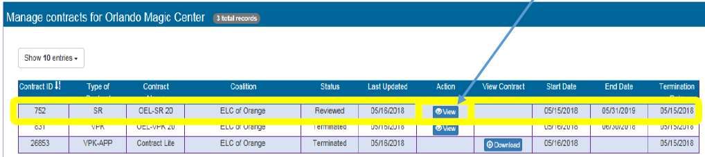

Finding Your SR Reimbursement Rate
In the Provider Portal, look for Contracts, then Manage Contracts, find the SR-20 for this year, then open to view, and go to Exhibit 3.
Go to bottom of page
Notes:
You can find information on your approved SR Reimbursement Rate in the Provider Portal. Look for Contracts, then Manage Contracts, find the SR-20 contract for the year. Select View to open the contract, then go to the bottom of the page to select Next Step. Advance to Exhibit 3.

Slide 5
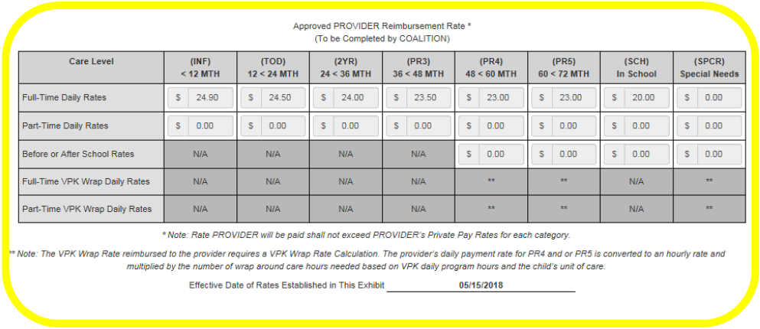
Finding Your SR Reimbursement Rate
https://4cflorida.org/wp-content/uploads/2019/01/Instructions-for-Finding-Provider-Rates.pdf
Notes:
In Exhibit 3, you’ll find a chart showing your private pay rates, the Coalition’s maximum provider rates and the third section will show the “Approved Provider Reimbursement Rate”. This is the rate you will be paid.
There are detailed instructions of this information on the 4C website.

