Slide 1


REPORTING TEMPORARY CLOSURES FOR SR AND VPK
USING THE EARLY LEARNING COALITION PROVIDER PORTAL

Slide 2
THREE TYPES OF TEMPORARY CLOSURES
Select the type of childcare services closure that occurred during the closure event.
The whole site(s) was closed. Services were not provided to any children.
The site was partially closed. Services were not provided to all or some VPK classes.
The site was partially closed. Services were not provided to all or some SR care levels.

Slide 3
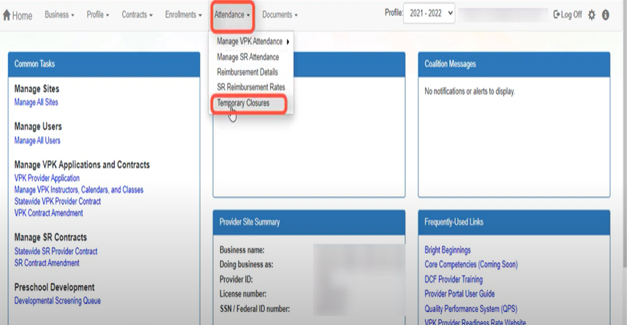
STEPS TO REPORT WHOLE SITE CLOSURE USING THE PROVIDER PORTAL
Provider clicks on Attendance.
Provider clicks on Temporary Closure from the drop down box.

Slide 4
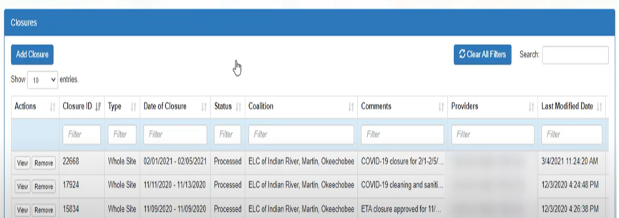
Step 3. Provider selects on “Add Closure”.

Slide 5
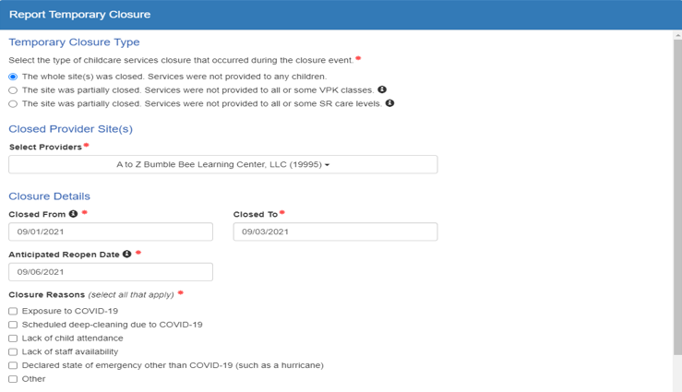
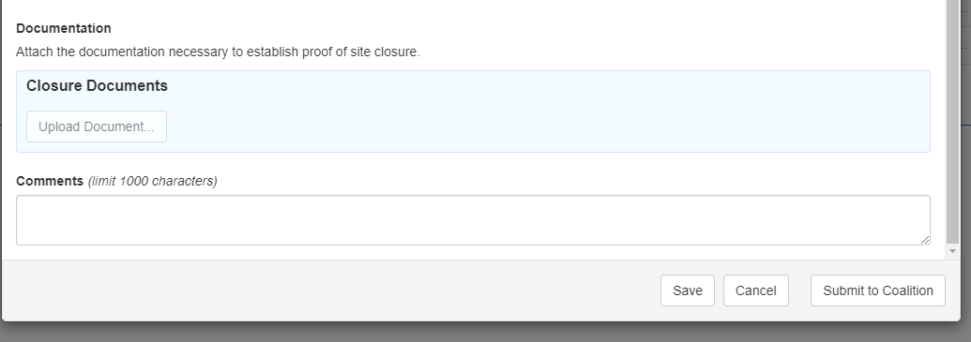
STEP 4. PROVIDER CHOOSES CLOSURE TYPE AND COMPLETES CLOSURE DETAILS.
WHOLE SITE WAS CLOSED. NO SERVICES PROVIDED.
SITE NAME
CLOSURE DATES
IT IS VERY IMPORTANT TO ATTACH/UPLOAD COPIES OF CLOSURE DOCUMENTS.
ADD COMMENTS, THEN SELECT
“SAVE” AND FINALLY
HIT “SUBMIT TO COALITION”.
CLOSURE REASON
UPLOAD DOCUMENTATION

Slide 6
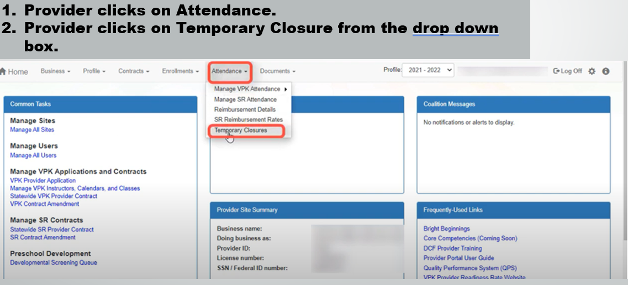
STEPS TO REPORT SITE WAS PARTIALLY CLOSED FOR ALL OR SOME VPK CLASSES

Slide 7
STEP 3. PROVIDER SELECTS “ADD CLOSURE”.

Slide 8
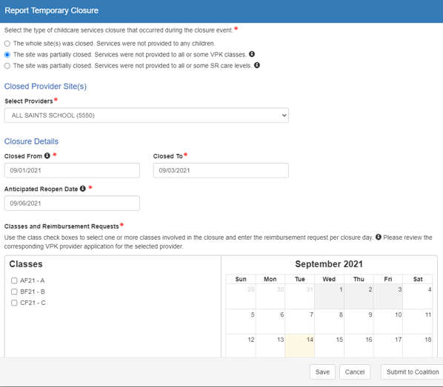
STEP 4. PROVIDER CHOOSES CLOSURE TYPE AND COMPLETES CLOSURE DETAILS.
PARTIALCLOSURE FOR ALL OR SOME VPK CLASSES
SITE NAME FROM DROP DOWN BOX
CLOSURE DATES
AND REOPEN DATE
ONCE CLASSES ARE CHOSEN, THE CALENDAR POPULATES AND CLOSURE DATES ARE SHOWN
CHOOSE CLASSES AFFECTED BY CLOSURE

Slide 9
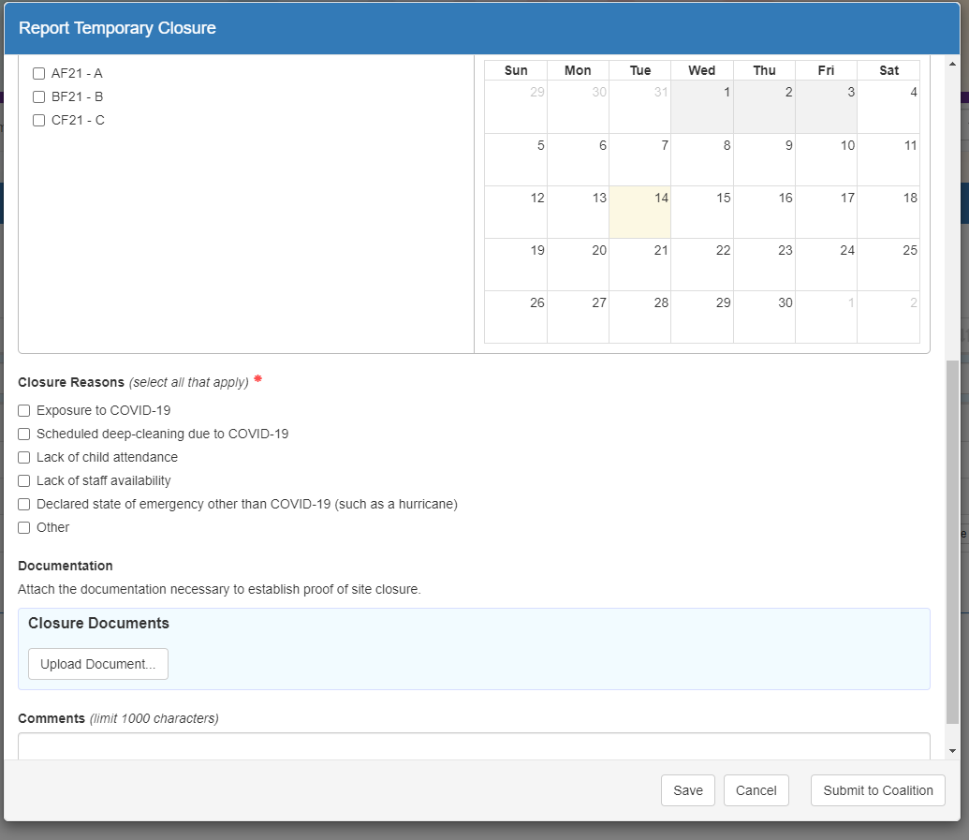
STEP 5. PROVIDER THEN CHOSES CLOSURE REASON.
IT IS VERY IMPORTANT TO ATTACH/UPLOAD COPIES OF CLOSURE DOCUMENTS.
ADD COMMENTS, THEN HIT “SAVE” AND FINALLY
HIT “SUBMIT TO COALITION”.
CLOSURE REASON
UPLOAD DOCUMENTATION

Slide 10
STEPS TO REPORT SITE WAS PARTIALLY CLOSED FOR ALL OR SOME SR CLASSES

Slide 11
STEP 3. PROVIDER CLICKS ON “ADD CLOSURE”.

Slide 12
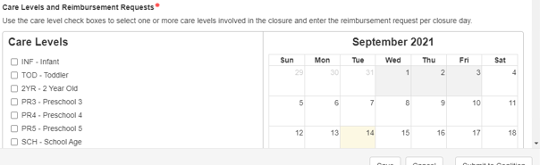
STEP 4. PROVIDER CHOOSES CLOSURE TYPE AND COMPLETES CLOSURE DETAILS.
PARTIALCLOSURE FOR ALL OR SOME SR CLASSES
SITE NAME FROM DROP DOWN BOX
CLOSURE DATES
AND REOPEN DATE
ONCE CLASSES ARE CHOSEN, THE CALENDAR POPULATES AND CLOSURE DATES ARE SHOWN
CARE LEVELS AFFECTED BY CLOSURE
CHOOSE CLASSES AFFECTED BY CLOSURE

Slide 13
STEP 5. PROVIDER THEN CHOOSES CLOSURE REASON.
IT IS VERY IMPORTANT TO ATTACH/UPLOAD COPIES OF CLOSURE DOCUMENTS.
ADD COMMENTS, THEN HIT “SAVE” AND FINALLY
HIT “SUBMIT TO COALITION”
CLOSURE REASON
UPLOAD DOCUMENTATION

Slide 14

SUBMITTING ATTENDANCE
4C will notify you once your temporary closures have been approved.
Continue to submit attendance as usual by the 3rd business day of the month.
DON’T MISS THE DUE DATE

Slide 15
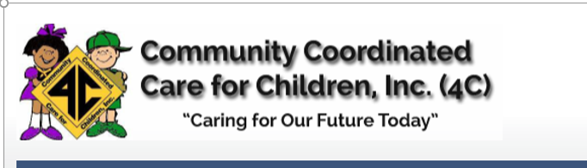
ADDITIONAL TRAINING RESOURCES LOCATED AT 4cflorida.org

Slide 16
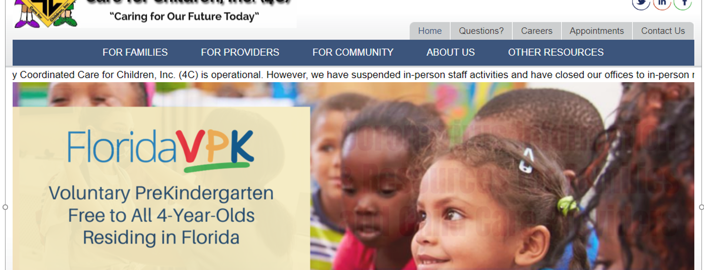
Providers click on “Other Resources”. Providers select “ELC Modernization Training, Resources” from the drop down menu.

Slide 17
TEMPORARY CLOSURES
TRAINING VIDEOS
Right click on the link. Select open hyperlink to start the video
How Providers Report a Temporary Closure for VPK Classes:
https://www.youtube.com/watch?v=XEEBArea-WQ&list=PLJ0Zv3ZSaqVKIdr0IvfgawaZtUckXzy8O&index=2
How Providers Report a Temporary Closure for Whole Site
https://www.youtube.com/watch?v=8vT4NX6WFSQ&list=PLJ0Zv3ZSaqVKIdr0IvfgawaZtUckXzy8O&index=3
How Providers Submit SR Attendance with Temporary Closures
https://www.youtube.com/watch?v=drlb_PMEbxM&list=PLJ0Zv3ZSaqVKIdr0IvfgawaZtUckXzy8O&index=4

Slide 18
TEMPORARY CLOSURES
TRAINING VIDEOS
Right click on the link. Select open hyperlink to start the video
How Providers Update a VPK Class Calendar when Share with One or More Classes
https://www.youtube.com/watch?v=A_bbxlZNXyM&list=PLJ0Zv3ZSaqVKIdr0IvfgawaZtUckXzy8O&index=5
How Providers View Temporary Closures on VPK Attendance Rosters
https://www.youtube.com/watch?v=O1-NVv3UezE&list=PLJ0Zv3ZSaqVKIdr0IvfgawaZtUckXzy8O&index=6
How VPK Providers Update Calendars Due to Temporary Closures
https://www.youtube.com/watch?v=37WcJCUqRKE&list=PLJ0Zv3ZSaqVKIdr0IvfgawaZtUckXzy8O&index=7

Slide 19


Contact the Provider Technical Assistance Line at 407-532-4113 or Your Reimbursement Specialist.

